Slide 1
State abstraction for decision making
Lepauvre, Alex
Post doctoral researcher at Faculty of Psychology
Methods for reducing complex MDPs
Dysco lab meeting
12-11-2025

Slide 2
Introduction
Wake up
Eat breakfast
Stay in bed
Go back to bed
Take a shower
Eat breakfast
Christmas shopping
Drink coffee
Take shower
Go back to bed
Drink coffee
Christmas shopping
Lunch
Bike repair
Go back to bed
Christmas shopping
Bike repair
Grocery shopping
Grocery shopping
Bike repair
Dinner
Living life requires a lot of planning
We usually start the day with a set of goals
Buying christmas present
Repairing flat tire on my bike
Grocery shopping
Achieving goals requires planning
Shopping must be done within open hours
Need to manage homeostatic needs: eating, drinking, resting
Poor planning = failure to achieve goals
My Saturday

Slide 3





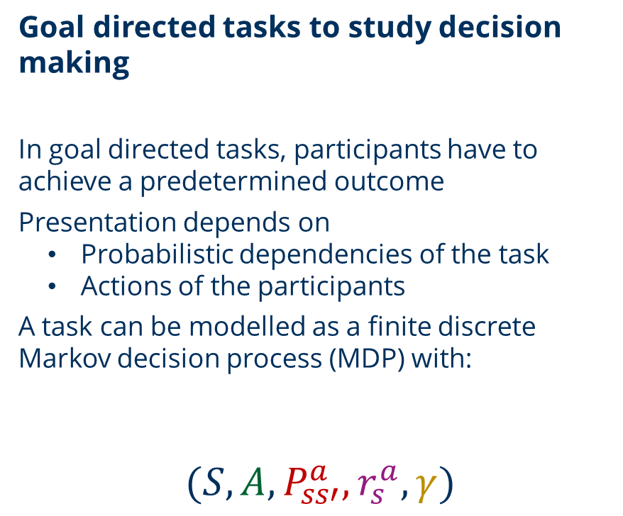













Introduction
Goal directed tasks to study decision making
In goal directed tasks, participants have to achieve a predetermined outcome
Presentation depends on
Probabilistic dependencies of the task
Actions of the participants
A task can be modelled as a finite discrete Markov decision process (MDP) with:
$$(S, A, P_{ss′}^{a}, r_{s}^{a}, γ)$$
$$s_{t}$$
$$r_{t}$$
Agent
$$a_{t}$$
$$r_{t+1}$$
Environment
$$s_{t+1}$$
$$S_{1}$$
$$r_{S_{1}}^{a_{1}}$$
$$r_{S_{1}}^{a_{2}}$$
$$a_{1}$$
$$a_{2}$$
Immediate
reward
$$P_{S_{1}S_{2}}^{a_{1}}$$
$$P_{S_{1}S_{4}}^{a_{2}}$$
Actions
$$P_{S_{1}S_{3}}^{a_{1}}$$
$$P_{S_{1}S_{3}}^{a_{2}}$$
States
Discount
factor
$$S_{2}$$
$$S_{3}$$
$$S_{4}$$
Transition
probability

Slide 4
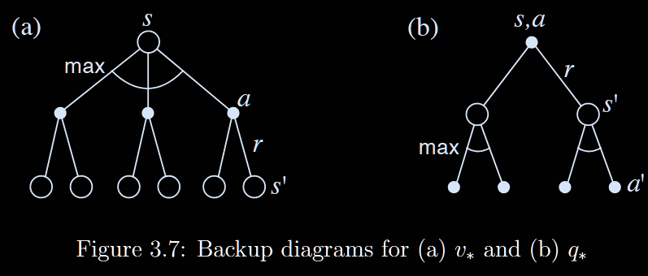
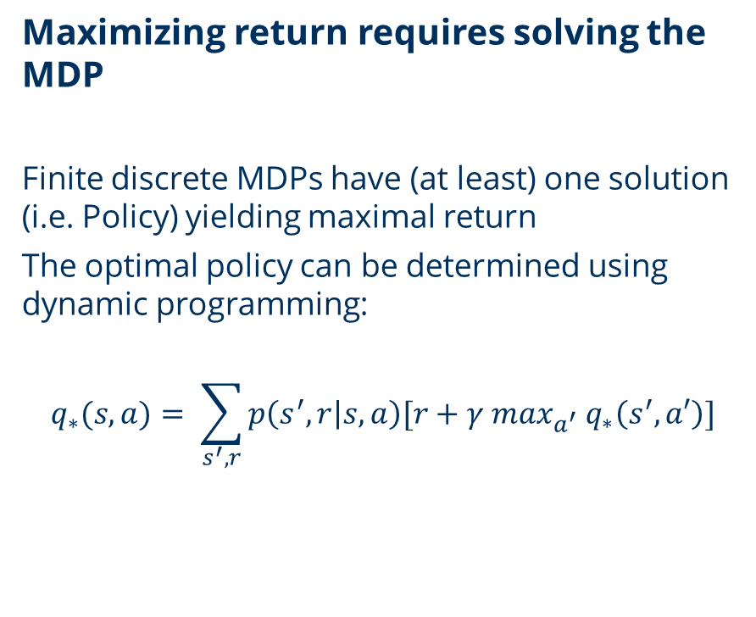
Introduction
Maximizing return requires solving the MDP
Finite discrete MDPs have (at least) one solution (i.e. Policy) yielding maximal return
The optimal policy can be determined using dynamic programming:
$$q_{∗}(s, a)= \sum_{s^{′}, r}{p\left(s^{′}, r | s,a\right)[r+γ\max_{a^{′}} q_{∗}\left(s^{′}, a′\right)]}$$
Source: Reinforcement Learning: An Introduction, Sutton and Barto, 2018

Slide 5
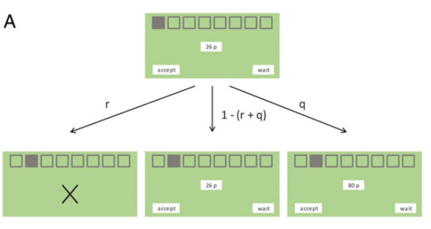
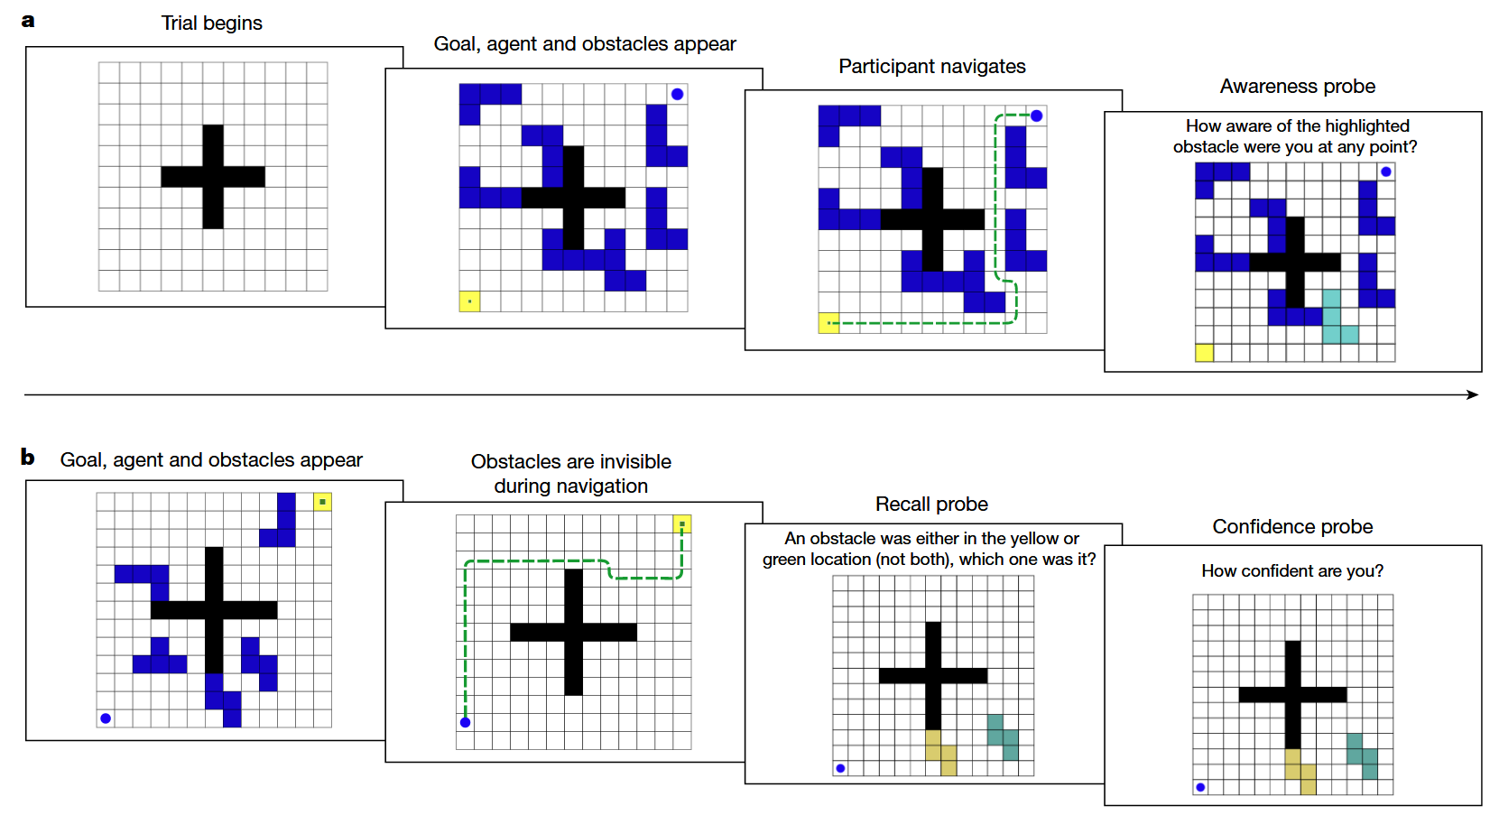
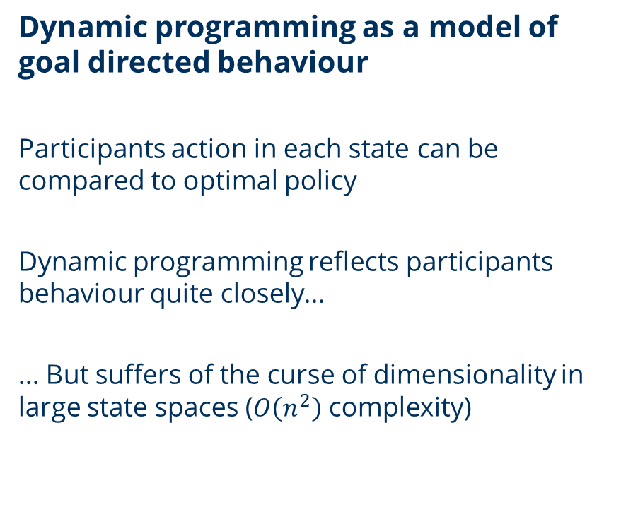
Introduction
Dynamic programming as a model of goal directed behaviour
Participants action in each state can be compared to optimal policy
Dynamic programming reflects participants behaviour quite closely...
... But suffers of the curse of dimensionality in large state spaces ($O\left(n^{2}\right)$ complexity)
Source: Schwartenbeck, P. at al.(2015). The dopaminergic midbrain encodes the expected certainty about desired outcomes. Cerebral cortex, 25(10), 3434-3445. Ho, M. K., Abel, D., Correa, C. G., Littman, M. L., Cohen, J. D., & Griffiths, T. L. (2022). People construct simplified mental representations to plan. Nature, 606(7912), 129-136.

Slide 6
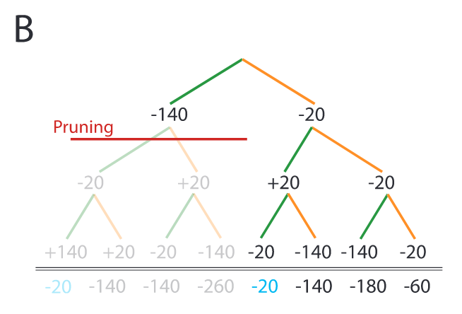
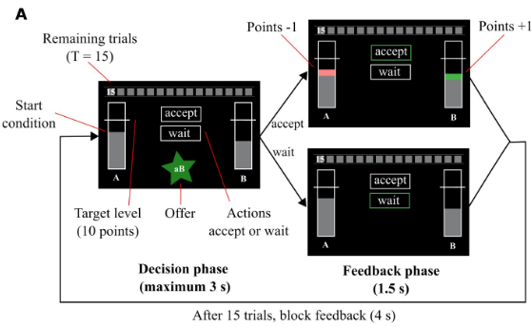
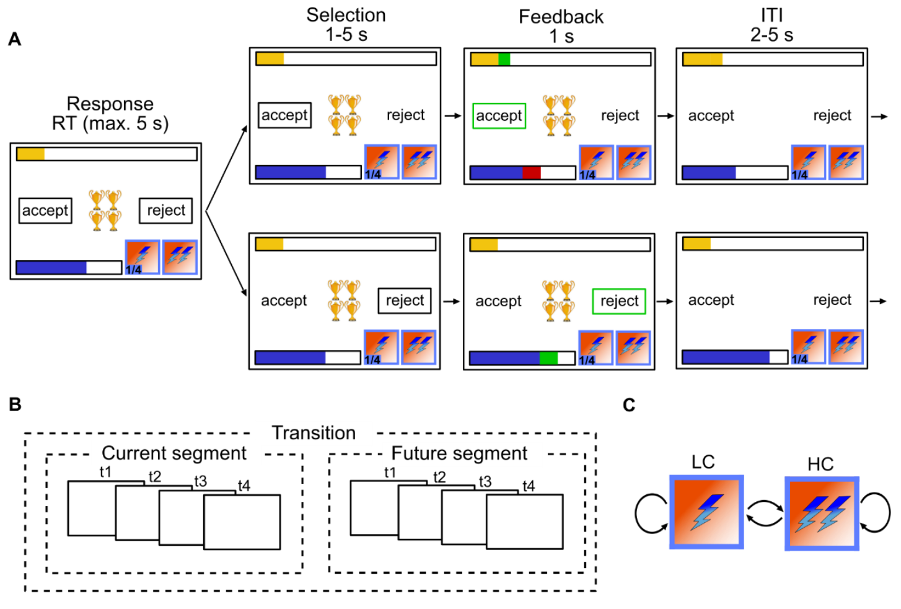
Introduction
Participants might (somehow) represent reduced MDP and plan on those
Ignoring some aspects of the problem for planning is better than no planning at all
Recent work suggest that participants apply heuristic, essentially ignoring aspects of the problem when planning
How to determine which aspects to ignore? How do participants reduce state space size?
Source: Huys, Q. J et al.. (2012). Bonsai trees in your head: how the pavlovian system sculpts goal-directed choices by pruning decision trees. PLoS computational biology. Ott, F. et al. (2020). Dynamic integration of forward planning and heuristic preferences during multiple goal pursuit. PLoS computational biology. Ott, F., et al. (2022) Forward planning driven by context-dependant conflict processing in anterior cingulate cortex. NeuroImage

Slide 7
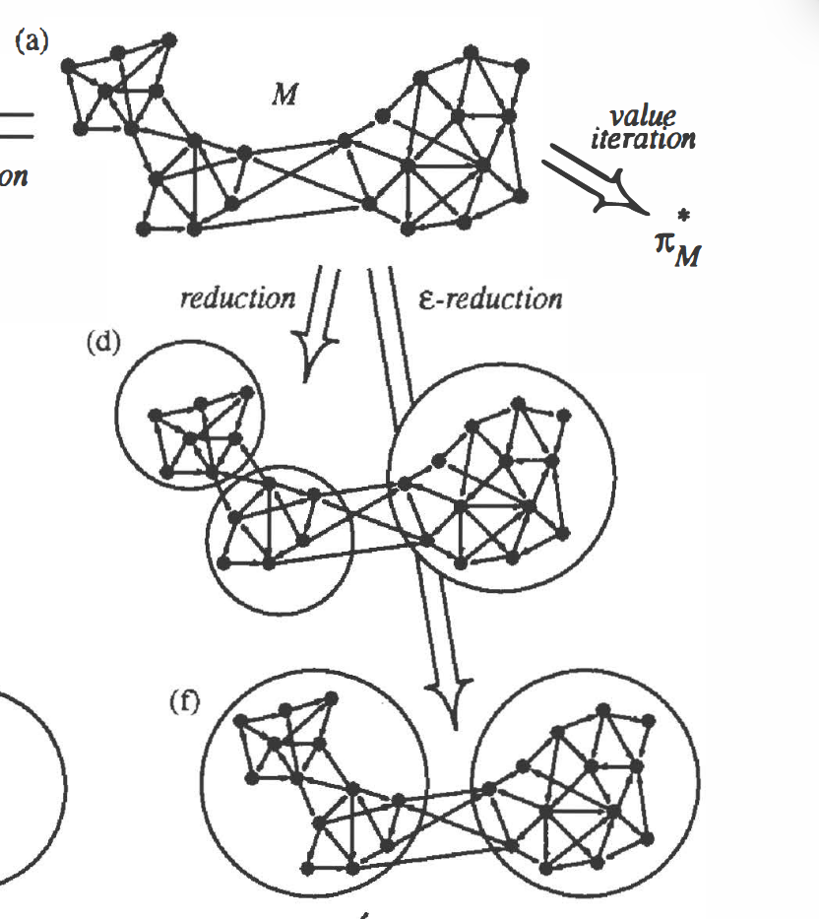
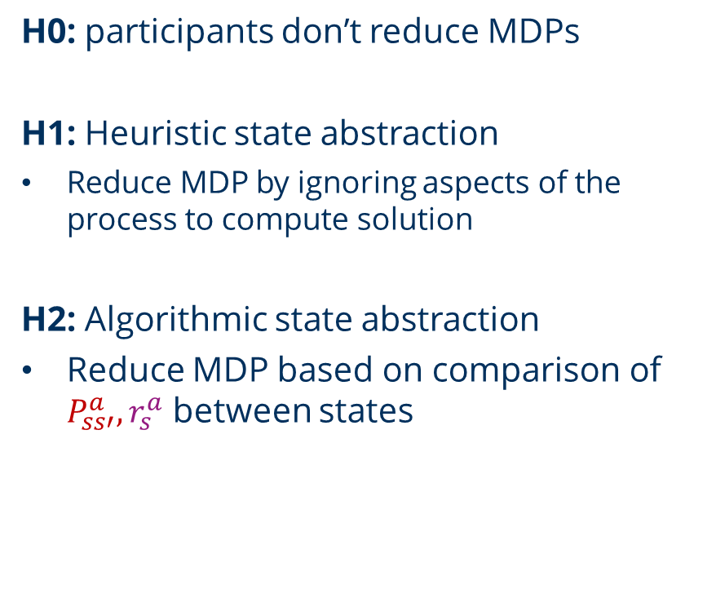
Hypotheses
H0: participants don’t reduce MDPs
H1: Heuristic state abstraction
Reduce MDP by ignoring aspects of the process to compute solution
H2: Algorithmic state abstraction
Reduce MDP based on comparison of $P_{ss′}^{a}, r_{s}^{a}$ between states
Source: Givan, T. L. et al.. (2012). Model Reduction Techniques for Computing Approximately Optimal Solutions for Markov Decision Processes

Slide 8
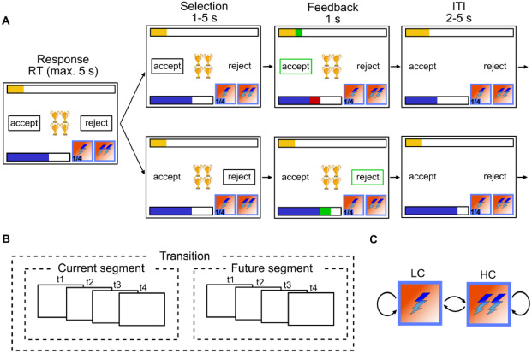
Experimental paradigm
Sequential decision task with large state space
In our task, participants are presented with offers (o) associated wiht a cost (c) on each trial
If accept:
Reward = o
Energy_{t+1} = Energy_{t} – c
If reject:
Reward = 0
Energy_{t+1} = Energy_{t} + 1
If Energy_{t} < c -> can‘t gain reward
Participants know the cost of future reward up until a horizon

Slide 9
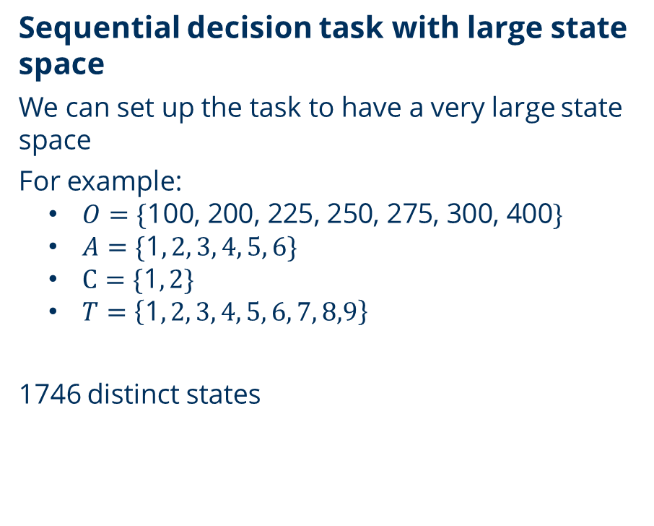
Experimental paradigm
Sequential decision task with large state space
We can set up the task to have a very large state space
For example:
$O=\{\text{100, 200, 225, 250, 275, 300, 400}\}$
$A=\{\text{1}, 2, 3, 4, 5, 6\}$
$C=\{\text{1}, 2\}$
$T=\left\{\text{1}, 2, 3, 4, 5, 6, 7, 8,9\right\}$
1746 distinct states

Slide 10
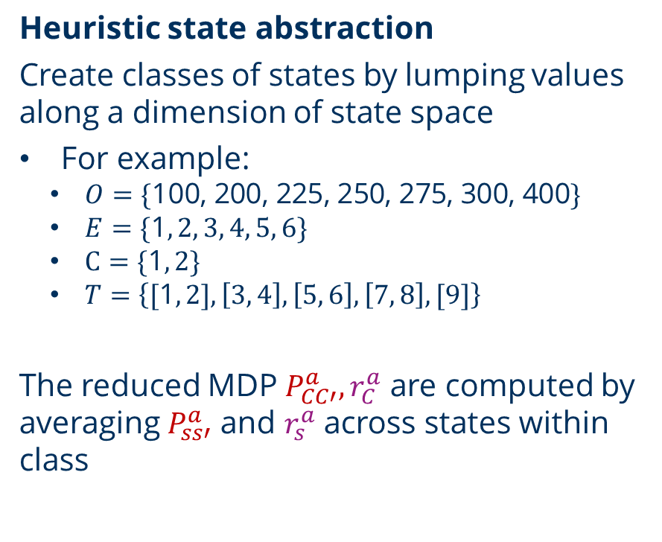
State abstraction methods
Heuristic state abstraction
Create classes of states by lumping values along a dimension of state space
For example:
$O=\{\text{100, 200, 225, 250, 275, 300, 400}\}$
$E=\{\text{1}, 2, 3, 4, 5, 6\}$
$C=\{\text{1}, 2\}$
$T=\left\{\text{[}\text{1}, 2], \left[3, 4\right], \left[5, 6\right], \left[7, 8\right],[9]\right\}$
The reduced MDP $P_{CC′}^{a}, r_{C}^{a}$ are computed by averaging $P_{ss′}^{a}$ and $r_{s}^{a}$ across states within class
Class 1:
[(o=100, e=1, c=1, t=1) , (o=100, e=1, c=1, t=2)]
Class 2:
[(o=200, e=1, c=1, t=1) , (o=200, e=1, c=1, t=2)]
Class 3:
…

Slide 11
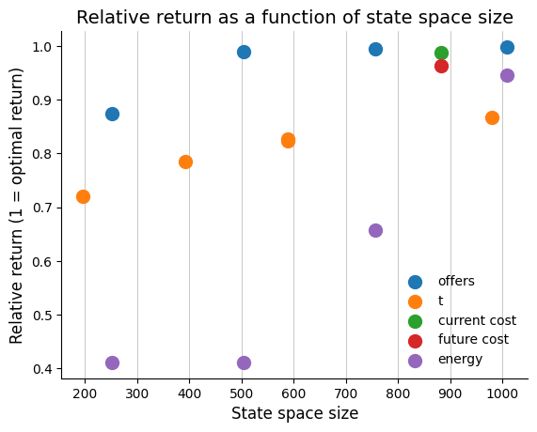
State abstraction methods
Heuristic state abstraction pipeline
Within each variable, compute any possible grouping (pairs, triplets…)
Solve reduced MDP using Dynamic programming
Evaluate policy obtained from reduced MDP on full MDP
Compare to optimal expected return
Relative
return

Slide 12
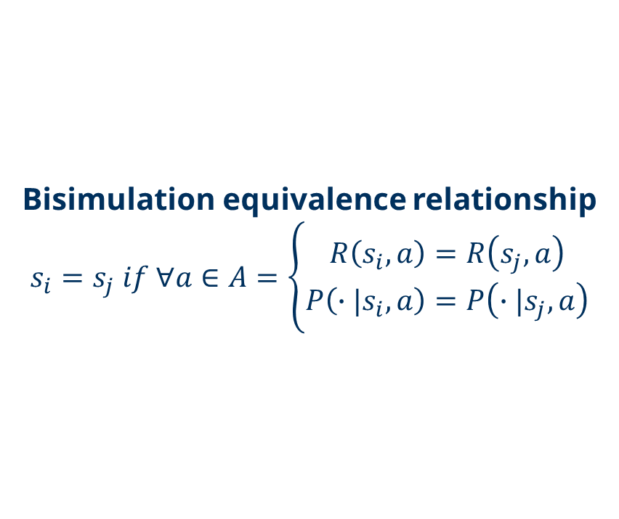
State abstraction methods
Algorithmic state abstraction
Seeks grouping of states that minimize the loss in value/policy accuracy
This is achieved based on the transition probability and rewards of the classes being grouped
Bisimulation is the strictest state abstraction method
Bisimulation equivalence relationship
$$s_{i}=s_{j} if ∀a∈A=\left\{\begin{aligned}R\left(s_{i}, a\right)=R\left(s_{j}, a\right) \\ P\left(∙|s_{i}, a\right)=P\left(∙|s_{j}, a\right)\end{aligned}\right.$$

Slide 13
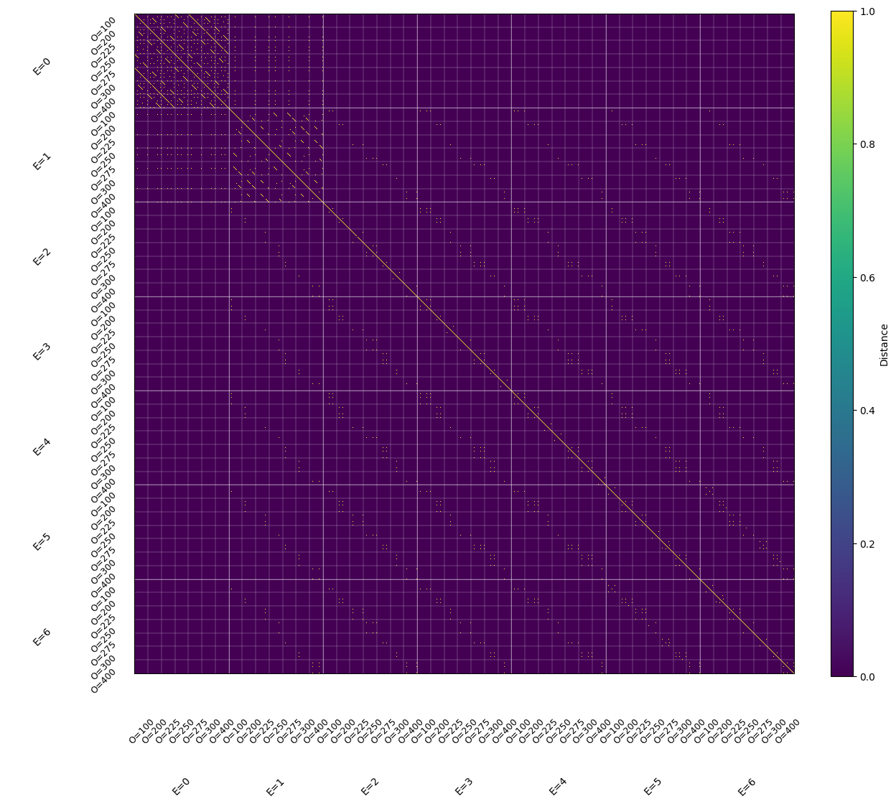
State abstraction methods
Bisimulation yields exact state space reduction
Optimal value function and policy are the same when computed on reduced and full MDP
For our MDP, bisimulation identifies 1200 unique classes

Slide 14
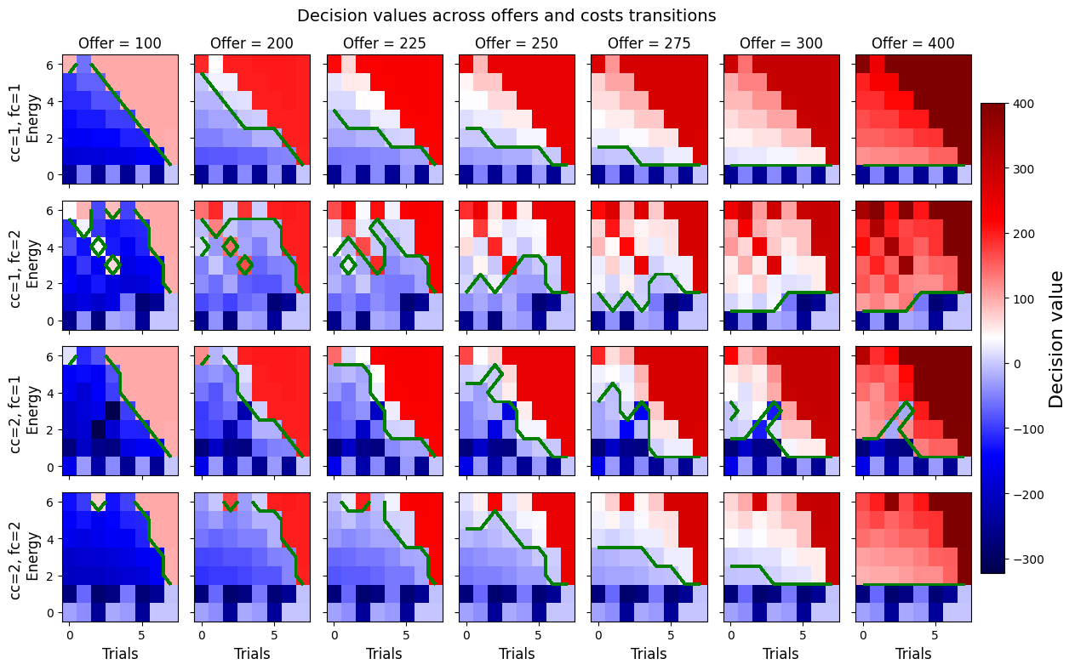
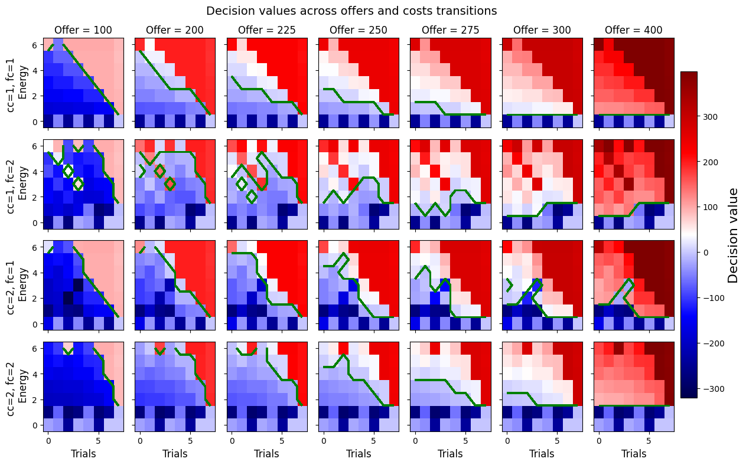
State abstraction methods
Full MDP decision values
Bisimulation yields exact state space reduction
Optimal value function and policy are the same when computed on reduced and full MDP
For our MDP, bisimulation identifies 1200 unique classes
Solving MDP on 1200 instead of 1746 states yields the exact same results
Reduced MDP decision values

Slide 15
State abstraction methods
Full MDP decision values
Bisimulation yields exact state space reduction
Optimal value function and policy are the same when computed on reduced and full MDP
For our MDP, bisimulation identifies 1200 unique classes
Solving MDP on 1200 instead of 1746 states yields the exact same results
But it only gets us so far:
We still have 1200 states
Can’t be dissociated behaviorally from full MDP
Reduced MDP decision values

Slide 16
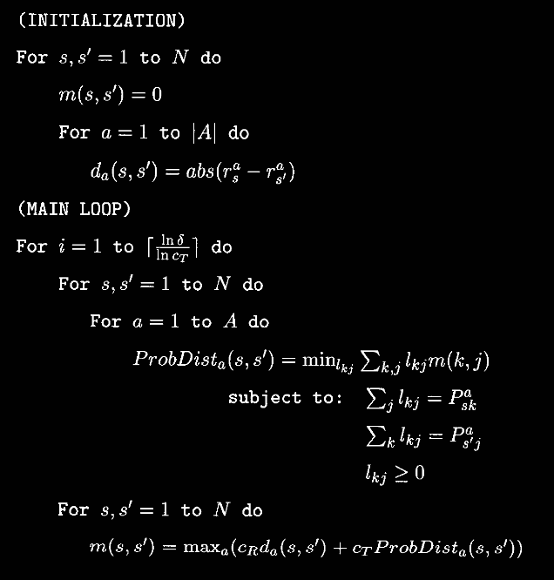
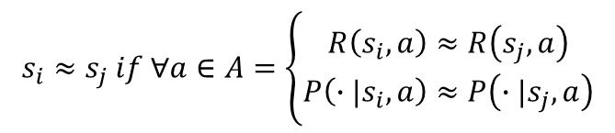
State abstraction methods
$$s_{i}≈s_{j} if ∀a∈A=\left\{\begin{aligned}R\left(s_{i}, a\right)≈R\left(s_{j}, a\right) \\ P\left(∙|s_{i}, a\right)≈P\left(∙|s_{j}, a\right)\end{aligned}\right.$$
Bisimulation metric as measure of the distance between states pairs
Bisimulation metric is a measure of similarity between states based on the notion of bisimulation
„states with about the same TP and reward are about the same“
Ferns et al. introduced a method to compute distance between states
Source: Ferns, Norm, Prakash Panangaden, and Doina Precup. "Metrics for Finite Markov Decision Processes." UAI. Vol. 4. 2004.

Slide 17
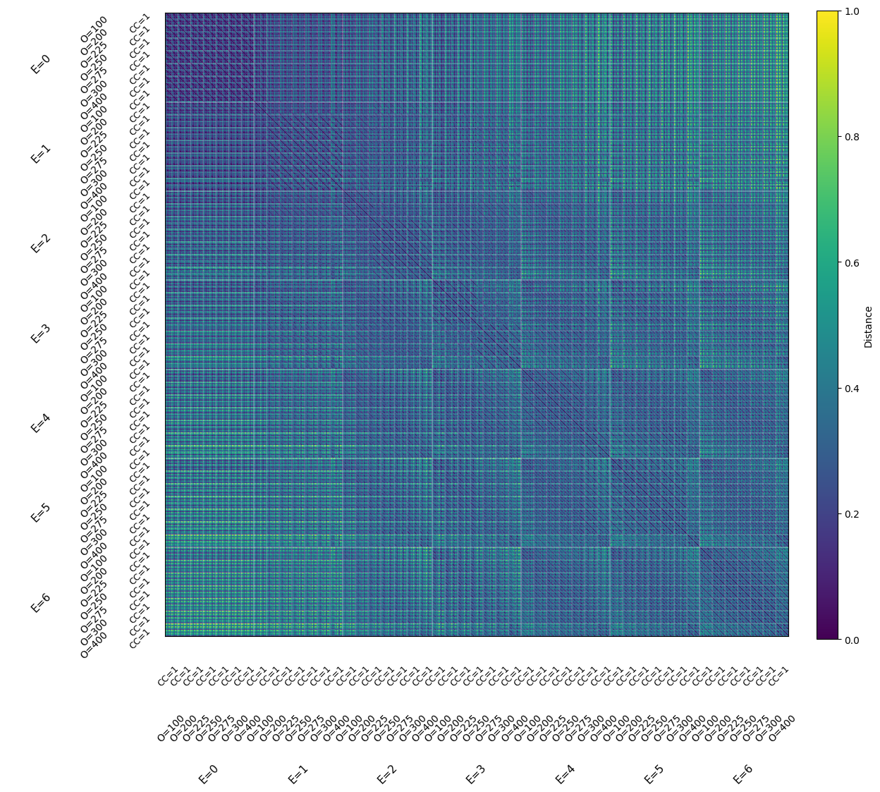
Bisimulation metric applied to our task

Slide 18
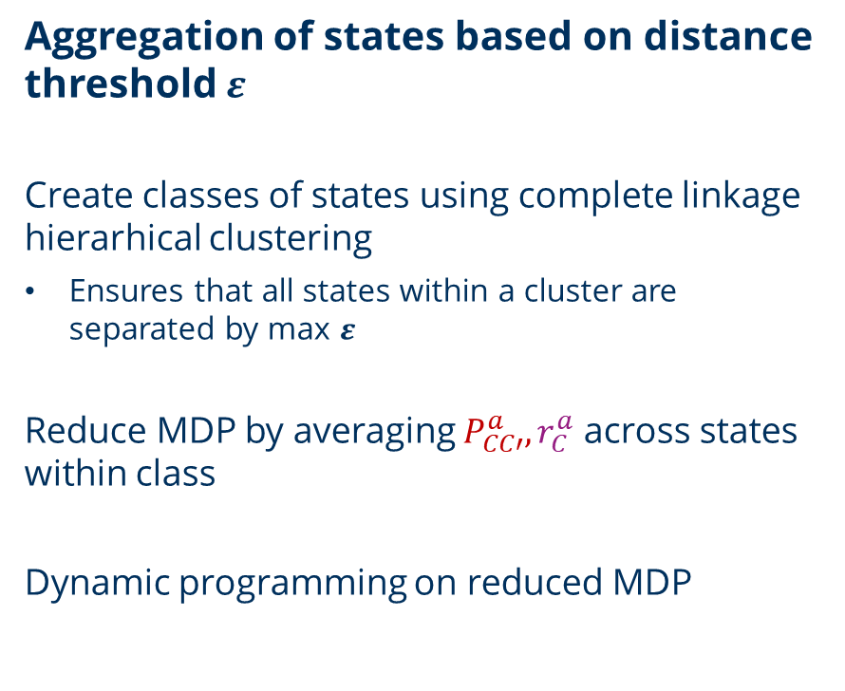
Bisimulation metric applied to our task
Aggregation of states based on distance threshold $ε$
Create classes of states using complete linkage hierarhical clustering
Ensures that all states within a cluster are separated by max $ε$
Reduce MDP by averaging $P_{CC′}^{a}, r_{C}^{a}$ across states within class
Dynamic programming on reduced MDP

Slide 19
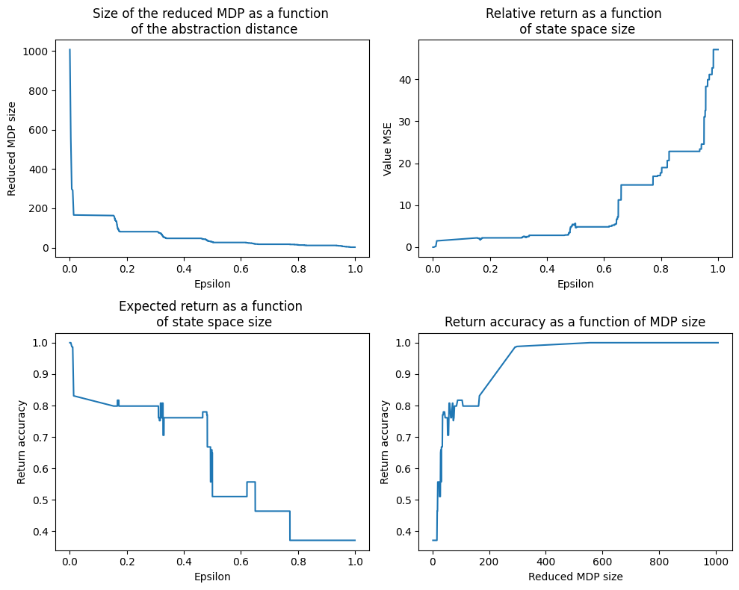
Abstraction based on states distances

Slide 20
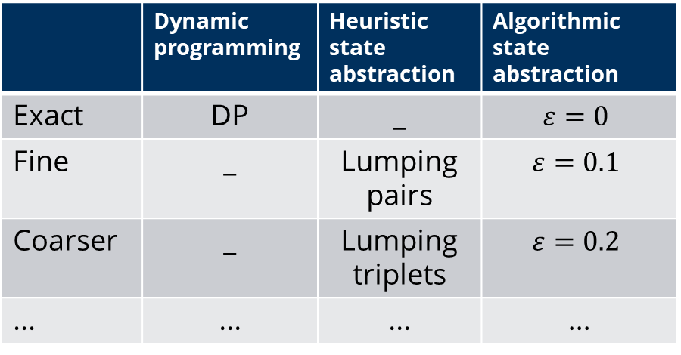
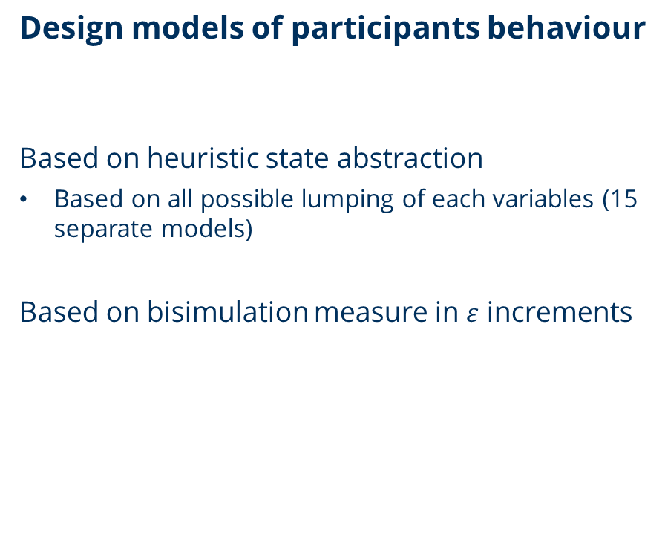
Study plan
Design models of participants behaviour
Based on heuristic state abstraction
Based on all possible lumping of each variables (15 separate models)
Based on bisimulation measure in $ε$ increments
Models
 | Dynamic programming | Heuristic state abstraction | Algorithmic state abstraction
Exact | DP | _ | $$ε=0$$
Fine | _ | Lumping pairs | $$ε=0.1$$
Coarser | _ | Lumping triplets | $$ε=0.2$$
... | ... | ... | ...
Abstraction
level

Slide 21
Study plan
Adjust experiment to maximize differences in decision values between model families
Modulate number of offers and energy levels
Adjust number of trials/segment
...

Slide 22
Study plan
Adjust experiment to maximize differences in decision values between model families
Modulate number of offers and energy levels
Adjust number of trials/segment
...
Repeat based on results of behavioural pilots

Slide 23
Discussion
How to select heuristic state abstraction models?
Use as many models as we have possible lumpings/variables?
Select models yielding the highest return for a given state space size?
Which bayesian stats package to use?
Despite being promising, bisimulation metric is even more computationally intensive than DP

Slide 24
Bisimulation metric
Difference in immediate reward
between s and s‘ under an action
Distance(s1, s2) = max([ ],
[ ])
Across actions
distance between s and s‘ TP
Source: Ferns, Norm, Prakash Panangaden, and Doina Precup. "Metrics for Finite Markov Decision Processes." UAI. Vol. 4. 2004.

Slide 25
Bisimulation metric
Earth mover distance between
probability distributions
Source: Ferns, Norm, Prakash Panangaden, and Doina Precup. "Metrics for Finite Markov Decision Processes." UAI. Vol. 4. 2004.

Slide 26
Bisimulation metric
Coupling
Source: Ferns, Norm, Prakash Panangaden, and Doina Precup. "Metrics for Finite Markov Decision Processes." UAI. Vol. 4. 2004.

Slide 27
Bisimulation metric
Coupling
Cost
Source: Ferns, Norm, Prakash Panangaden, and Doina Precup. "Metrics for Finite Markov Decision Processes." UAI. Vol. 4. 2004.

Slide 28
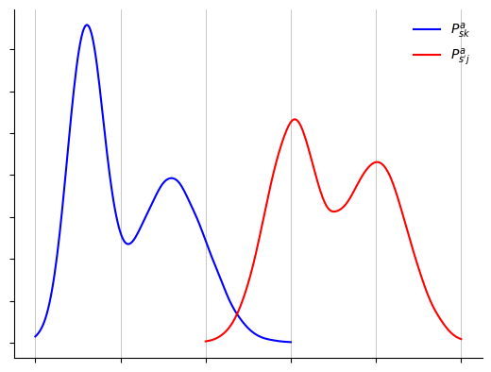

Bisimulation metric
$$l_{kj} ×c(k, j)$$
Source: Ferns, Norm, Prakash Panangaden, and Doina Precup. "Metrics for Finite Markov Decision Processes." UAI. Vol. 4. 2004.

Slide 29

Bisimulation metric
$$l_{kj} ×c(k, j)$$
Source: Ferns, Norm, Prakash Panangaden, and Doina Precup. "Metrics for Finite Markov Decision Processes." UAI. Vol. 4. 2004.

Slide 30
Bisimulation metric
$$l_{kj} ×c(k, j)$$
Marginal of the
coupling must be
s1 and s2 TP
Source: Ferns, Norm, Prakash Panangaden, and Doina Precup. "Metrics for Finite Markov Decision Processes." UAI. Vol. 4. 2004.

Slide 31
Bisimulation metric
Bisimulation metric iteratively estimates optimal transport cost
Estimated distance taken as EMD cost matrix
Propagating the reward difference backward in time
States distance ~ max(immediate reward difference & future returns)
Source: Ferns, Norm, Prakash Panangaden, and Doina Precup. "Metrics for Finite Markov Decision Processes." UAI. Vol. 4. 2004.

Slide 32
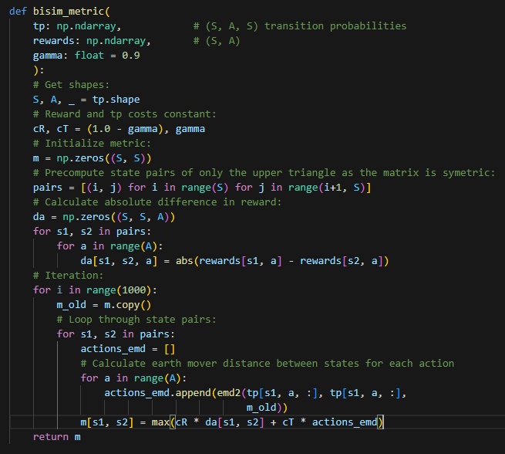
Bisimulation metric
Bisimulation metric iteratively estimates optimal transport cost
Estimated distance taken as EMD cost matrix
Propagating the reward difference backward in time
States distance ~ max(immediate reward difference & future returns)
Source: Ferns, Norm, Prakash Panangaden, and Doina Precup. "Metrics for Finite Markov Decision Processes." UAI. Vol. 4. 2004.

Slide 33
Experimental paradigm
We can still compute optimal solution using dynamic programming
Yields decision values (DV) for each state which we can use to model data
Unlikely to be how participants solve the task given how heavy the solution is

